Slide 1
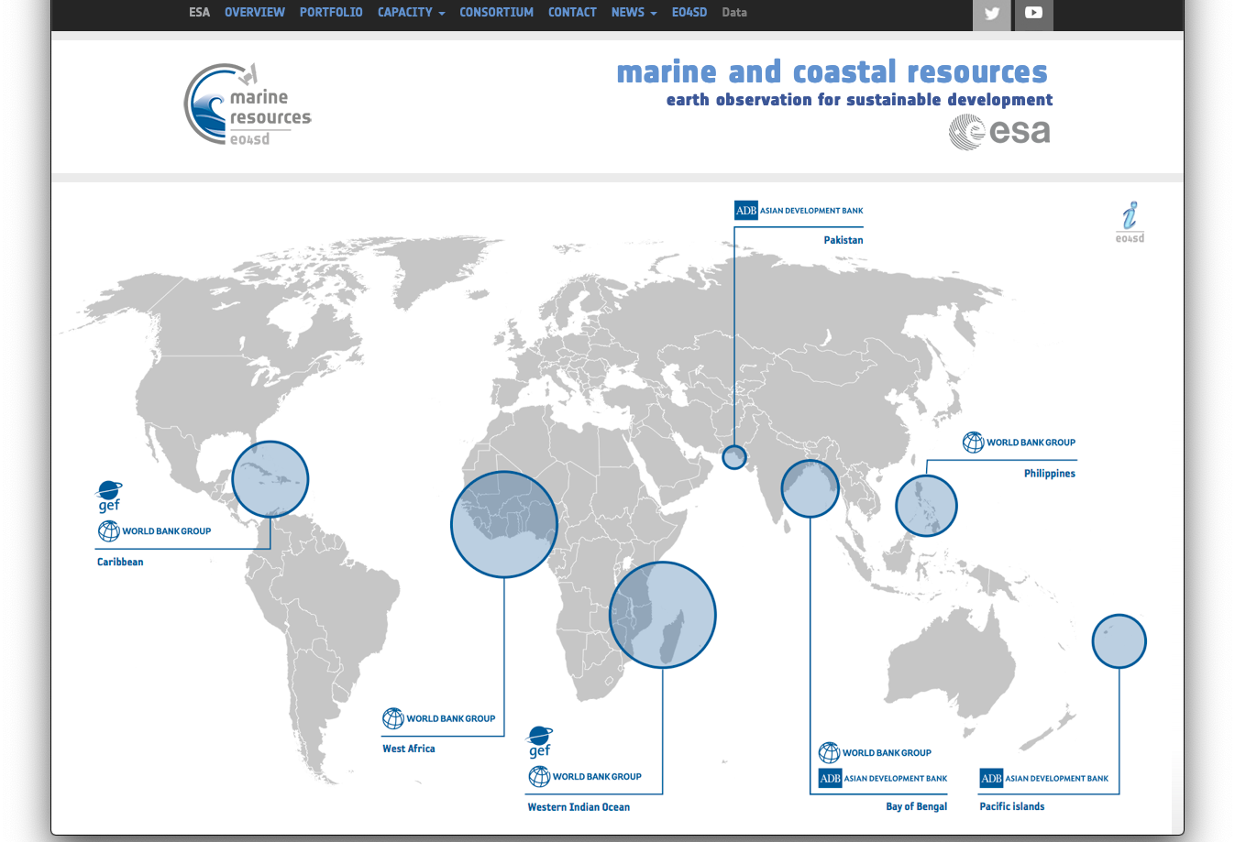
http://eo4sd.brockmann-consult.de

Slide 2
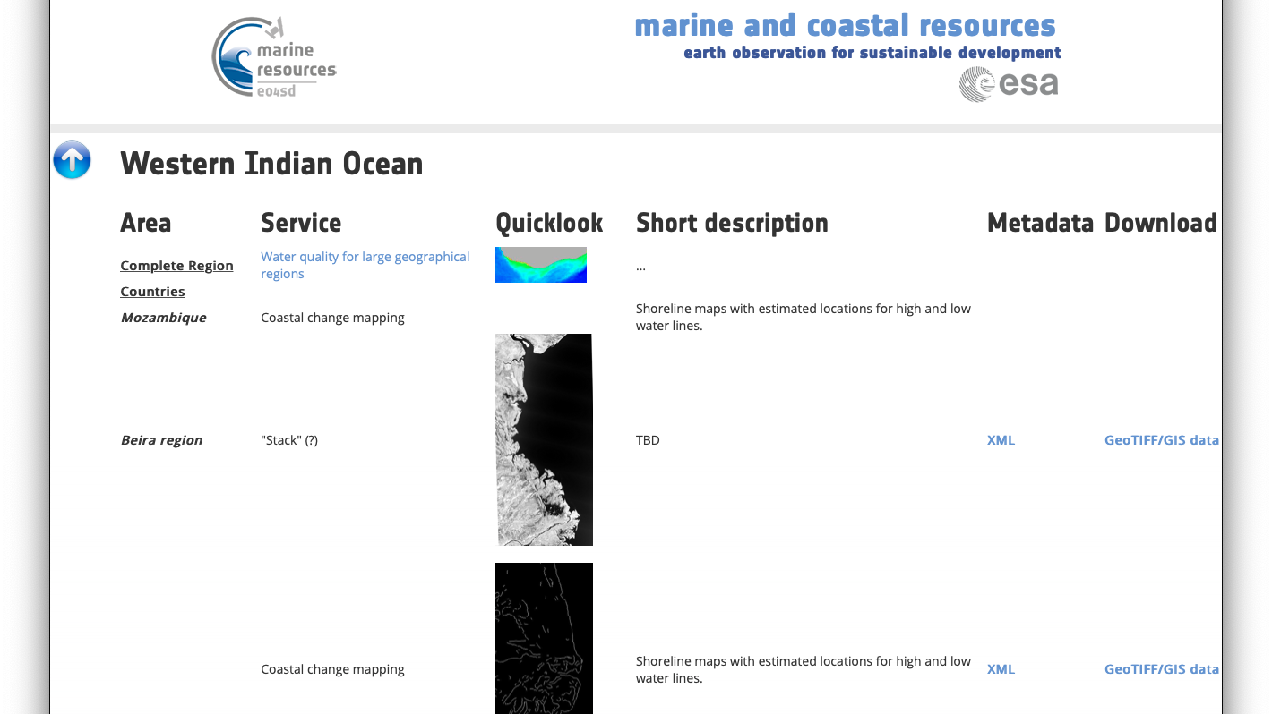

Slide 3
Questions
Mozambique data presently downloaded from S3 Bucket -> XML parsing
Will the next data be uploaded to the same location as the Mozambique data?
Or will it be put elsewhere? Server?
Notification?
Who will produce and provide the quicklooks /maps?
Other metadata: purpose of accompanying XML

